Slide 1

Orientation to Computing-I
L T P :2 0 0
www.lpu.in Lovely Professional University
‹#›

Slide 2

Unit 3 File system management
File system management :
File system basics, Types of file systems( FAT, GFT, HFS, NDFS, UDF, Extended file systems), Pipes and redirection, Searching the file system using find and grep with simple regular expressions, Basic process control using signals, pausing and resuming process from a Linux terminal, terminating a process, Adding/removing from search path using PATH variable.
Other Shell commands:
ls, cat, man, cd, touch, cp, mv, rmdir, mkdir, rm, chmod, pwd, ps, kill, etc, Kernel and types of kernels.
www.lpu.in Lovely Professional University
‹#›

Slide 3
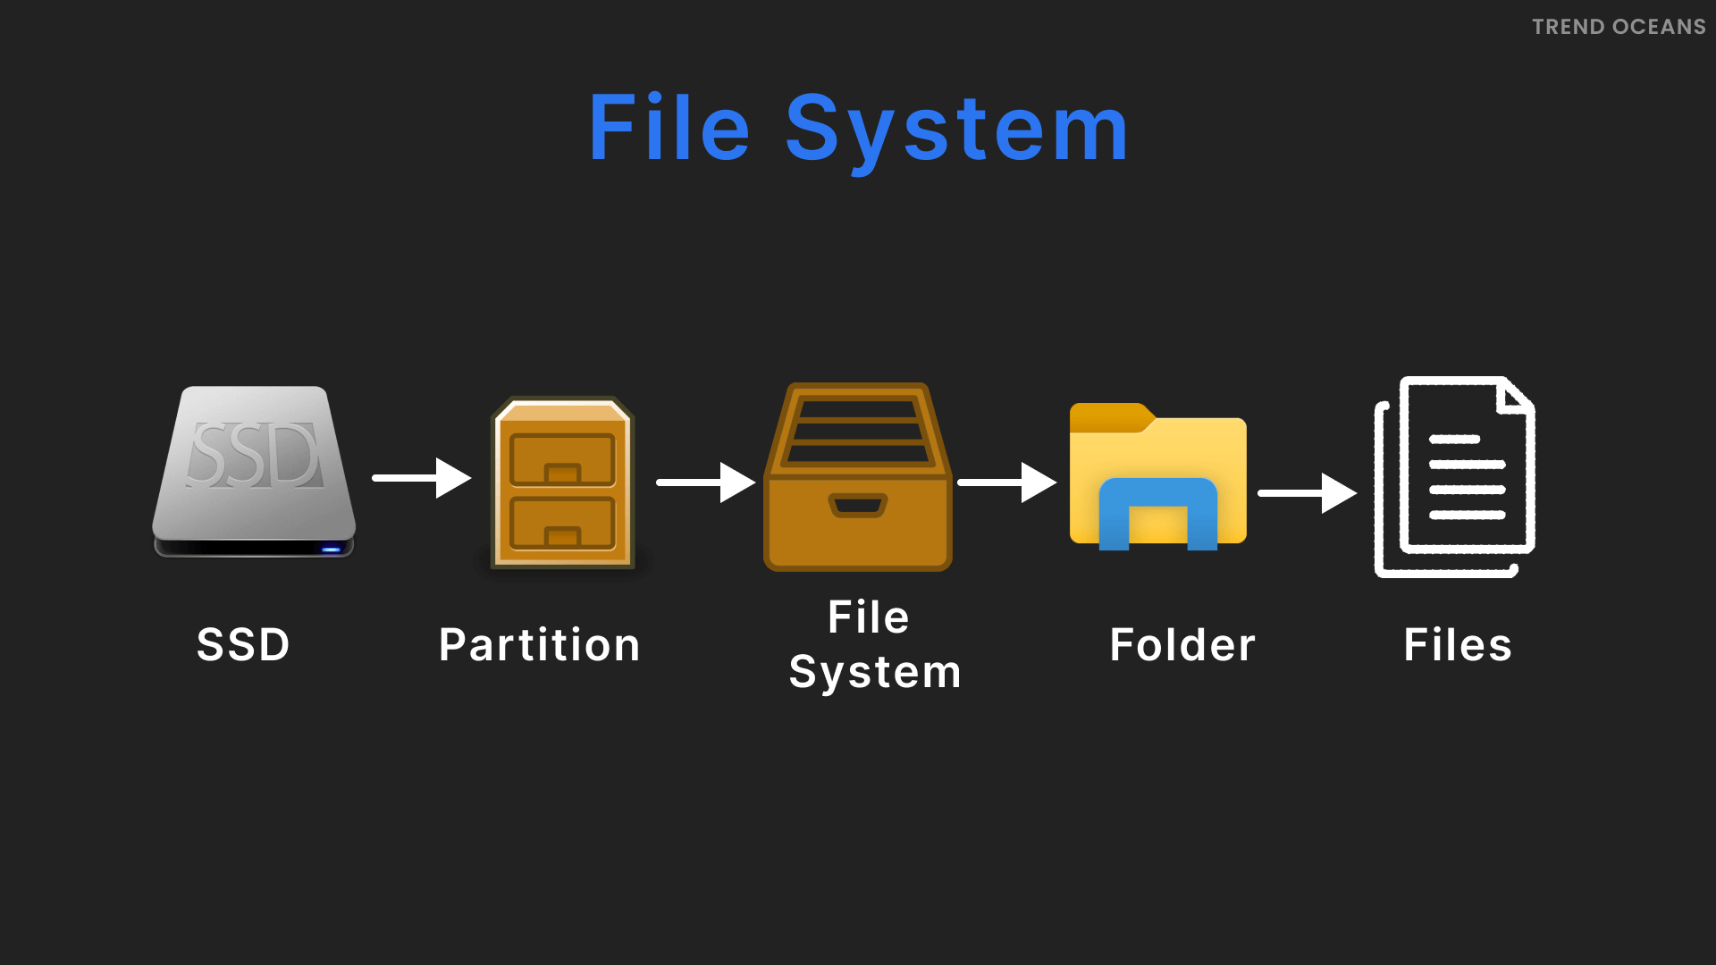
Understanding File System
File system is a structure used to organize data and programs on computer storage devices.
It keeps track of the physical locations of all data elements on disk and allows users to quickly and reliably retrieve files when needed.
Every operating system, from MS-DOS to Windows 95, Windows XP and Linux, has its own file system.
www.lpu.in Lovely Professional University
‹#›

Slide 4
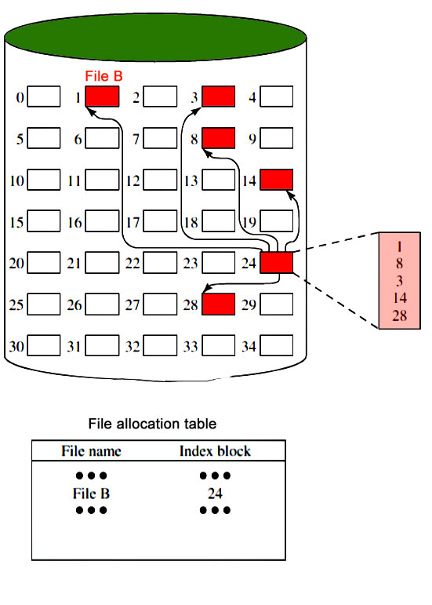
Representation of File System
www.lpu.in Lovely Professional University
‹#›

Slide 5
File can be..
Regular files
Directory Files
Device Files or Special Files
Regular Files stores data (text, binary, and executable)
Directory files contains information used to access other files.
Device Files defines a FIFO (first-in, first-out) pipe file or a physical device
www.lpu.in Lovely Professional University
‹#›

Slide 6
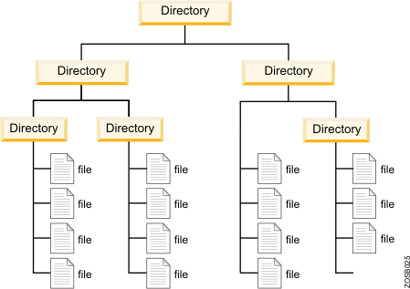
File System Representation
www.lpu.in Lovely Professional University
‹#›

Slide 7
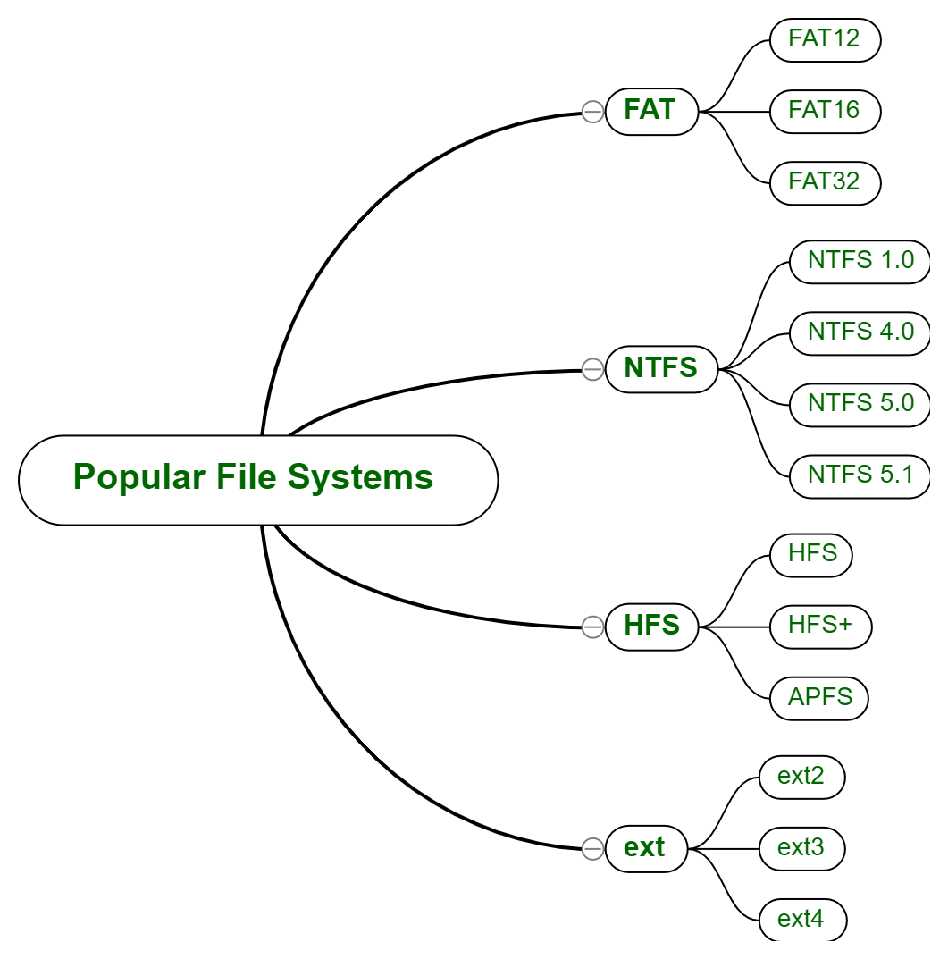
Popular File System
www.lpu.in Lovely Professional University
‹#›

Slide 8
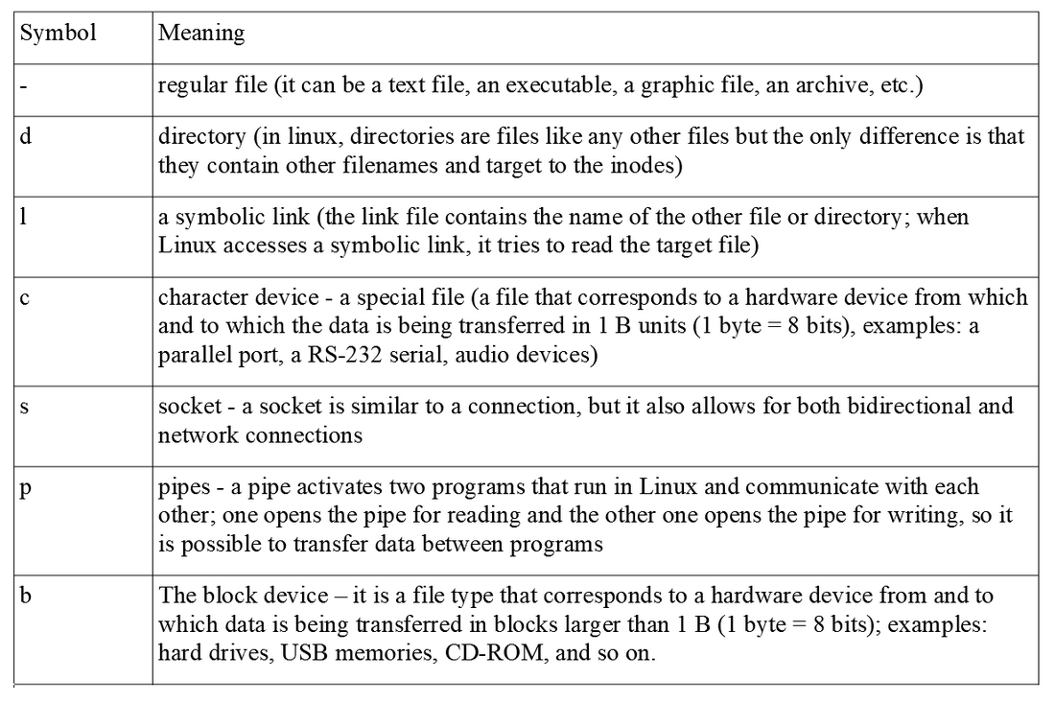
Useful Symbols for Files
www.lpu.in Lovely Professional University
‹#›

Slide 9
Types of File Systems
Following are the various file system in a device:
FAT
GIF
HDFS
DFS
UDF
Extended file system
NTFS
www.lpu.in Lovely Professional University
‹#›

Slide 10
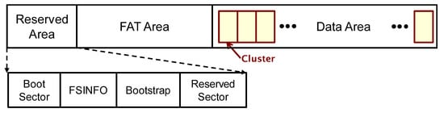
FAT File System
FAT32
Full form is file allocation table
One of the oldest file systems available on the windows machine.
Introduced on ms-dos 7.1 / windows 95 in 1996
Developed for floppy disks but later used on hard drive, USB flash drives, and SSD cards.
Until windows xp, it was default file system
FAT8, FAT12, and FAT16, FAT32 are its variations.
Structure of FAT32 File
www.lpu.in Lovely Professional University
‹#›

Slide 11
FAT32 contd..
Advantages:
Can hold up to 268,173,300 files
The backup FAT table copy gets automatically relocated to the root folder in FAT32 systems, which further can be used for the restoration of files.
Drive sizes are between 2 and 16 tb with 64kb clusters.
Is the official format for sd and sdhc cards.
Limitations:
Each file can have a maximum size of 4GB (GigaBytes).
No control over file permissions and data security.
The native disk’s maximum disk size for FAT32 is 32 GB. It is possible to expand it up to 2TB.
FAT32 is no longer used on modern, internal Windows hard drives as most systems have adopted the NTFS standard.
www.lpu.in Lovely Professional University
‹#›

Slide 12
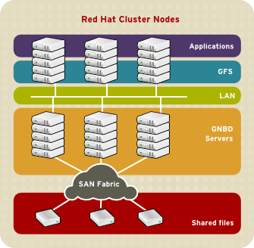
GFS File System
Full Form is Global File System
Is cluster of files that are shared between a number of computers and end systems from which data or services are accessed, stored and fetched.
A GFS reads and writes to the remote device
GFS Overview
www.lpu.in Lovely Professional University
‹#›

Slide 13
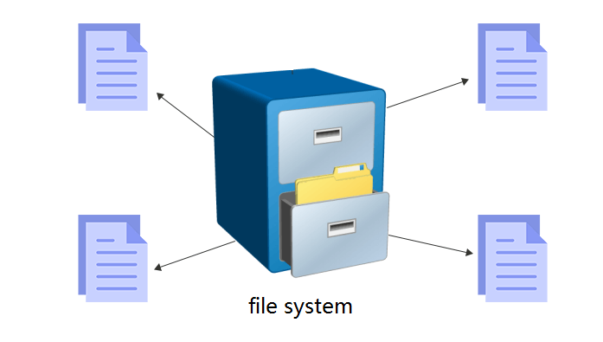
NTFS (New Technology File System)
NTFS:-
Current Windows versions beginning with Windows XP — use the NTFS file system to partition their code.
It is possible to format external drives with either FAT32 or NTFS.
www.lpu.in Lovely Professional University
‹#›

Slide 14
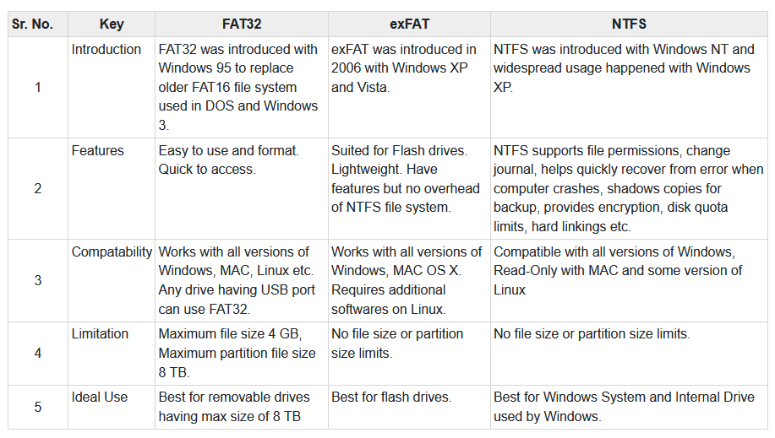
Differences between FAT32, exFAT, and NTFS File Systems.
www.lpu.in Lovely Professional University
‹#›

Slide 15
HFS File System
A file with the HFS file extension is an HFS disk image file.
Known as Hierarchical File System
Used to store the files on floppy disks, CD-ROM discs, and hard drives of older Apple Macintosh computers.
www.lpu.in Lovely Professional University
‹#›

Slide 16
Btrfs
Btrfs — "better file system" — is a newer, still in development, Linux file system.
It is a copy-on-write (CoW) filesystem.
The goal is to provide additional features that allow Linux to scale up to larger storage amounts.
www.lpu.in Lovely Professional University
‹#›

Slide 17
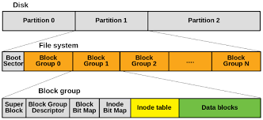
Ext2/Ext3/Ext4 File System
Known as Extended File System
On Ubuntu, you will often see the file systems Ext2, Ext3, and Ext4.
If the power is gone or a device crashes when writing to an ext2 disk, data may be lost.
Ext3 provides these features of robustness at the expense of some speed.
Ext4 is simpler and more modern, it's now the default file system on most Linux distributions, and it's faster.
Such file systems are not supported by Windows and Mac.
www.lpu.in Lovely Professional University
‹#›

Slide 18
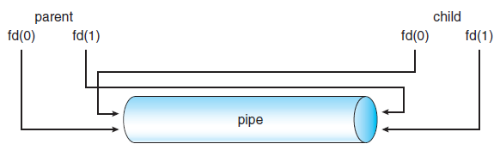
Concept of Pipes and Redirection
A pipe is a connection between two processes, such that the standard output from one process becomes the standard input of the other process.
In UNIX Operating System, Pipes are useful for communication between related processes(inter-process communication).
Although pipe can be accessed like an ordinary file, the system actually manages it as FIFO queue.
www.lpu.in Lovely Professional University
‹#›

Slide 19
Concept of Redirection
Redirection is for files (you redirect streams to/from files).
One common need when we run applications is to direct the output into a file instead of the terminal. A redirect sends a channel of output to a file.
This is typically done with the > operator between the application to run and the file to write the output into. For example, we can send the output of the ls command into a file called files as follows:
$ ls > files
www.lpu.in Lovely Professional University
‹#›

Slide 20
Searching the File System
Use command- find
It search for files in a directory hierarchy under Linux and all other UNIX like operating systems.
Examples:
find . - name thisfile.txt. ...
find /home -name *.jpg. Look for all . ...
www.lpu.in Lovely Professional University
‹#›

Slide 21
Searching the File System contd..
Use command- grep
Grep is an acronym that stands for Global Regular Expression Print.
The grep command searches through the file, looking for matches to the pattern specified.
Grep is case-sensitive.
Example:
grep myname biodata
Here biodata is file and myname is specific pattern for searching in biodata file
www.lpu.in Lovely Professional University
‹#›

Slide 22
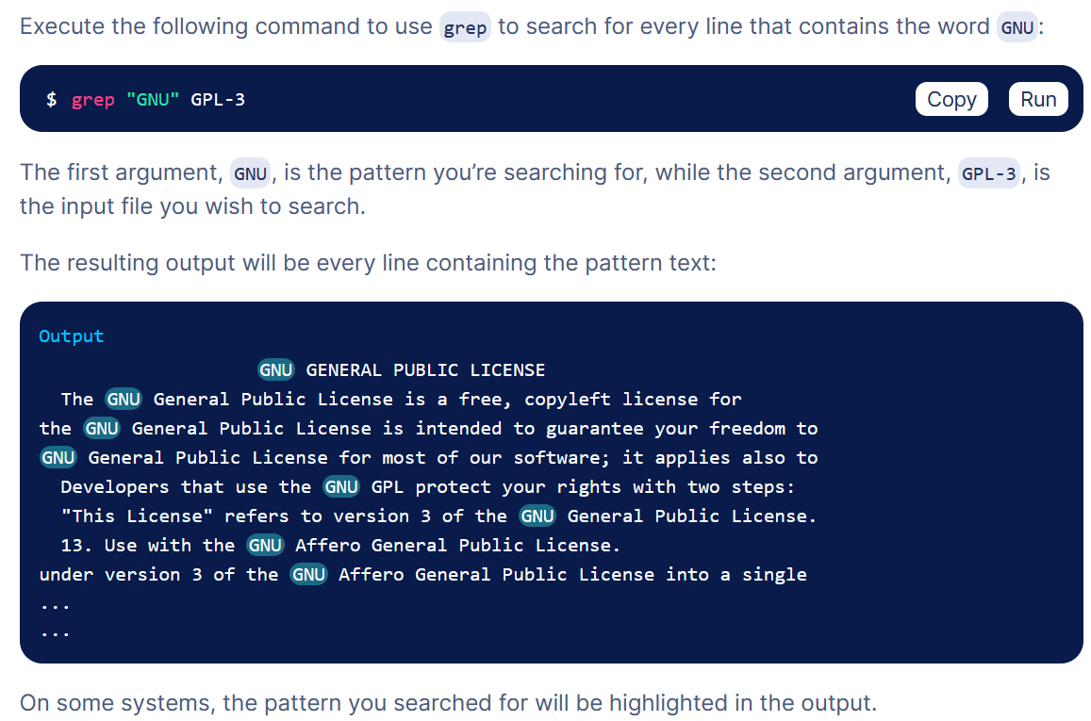
Use of grep
www.lpu.in Lovely Professional University
‹#›

Slide 23
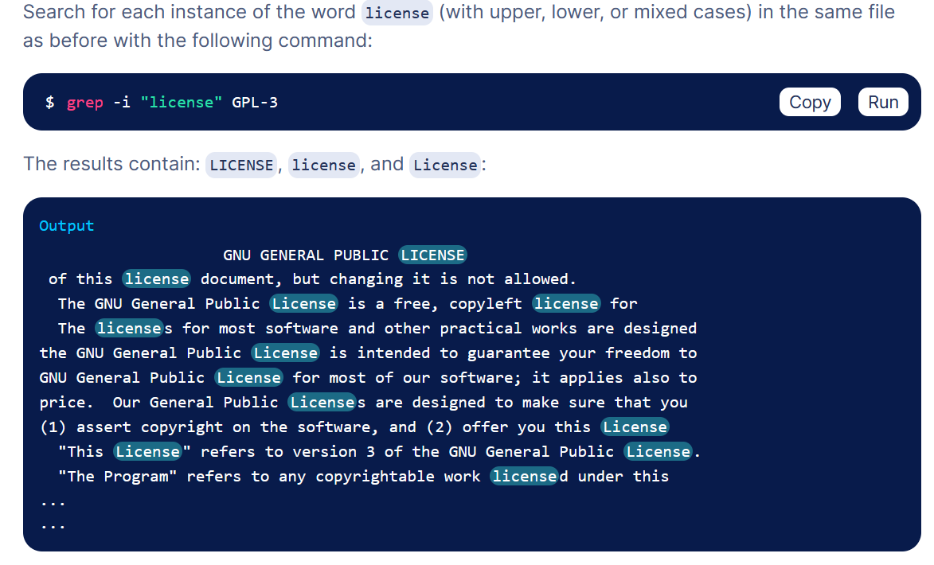
Use of grep contd..
www.lpu.in Lovely Professional University
‹#›

Slide 24
Process Signals
A signal is basically a one-way notification.
A signal can be sent by the kernel to a process, by a process to another process, or a process to itself.
Signals are one of the ways process communicate among themselves and with the kernel.
The list of the most commonly used signals follow:
SIGTERM: Surprisingly, the default signal sent by kill command.
Asks the process to terminate voluntarily.
SIGKILL: unlike SIGTERM, forces the process to terminate.
Can't be blocked or handled.
SIGSTOP: suspend the process execution.
www.lpu.in Lovely Professional University
‹#›

Slide 25
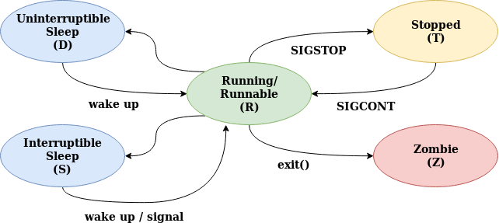
Process Signals contd..
www.lpu.in Lovely Professional University
‹#›

Slide 26
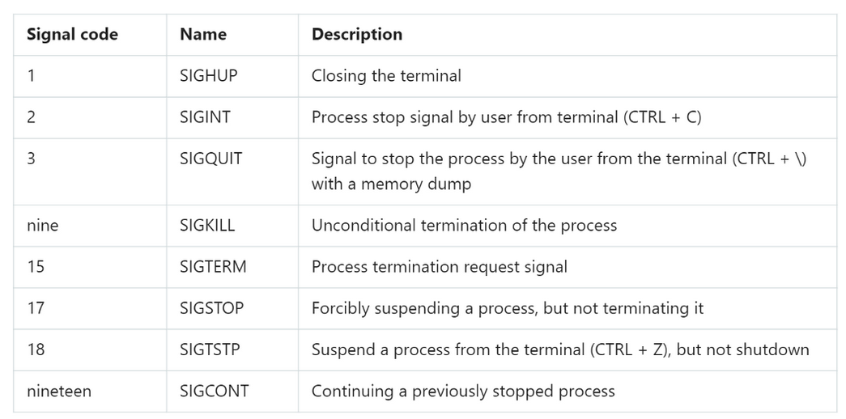
Description of Signals
www.lpu.in Lovely Professional University
‹#›

Slide 27
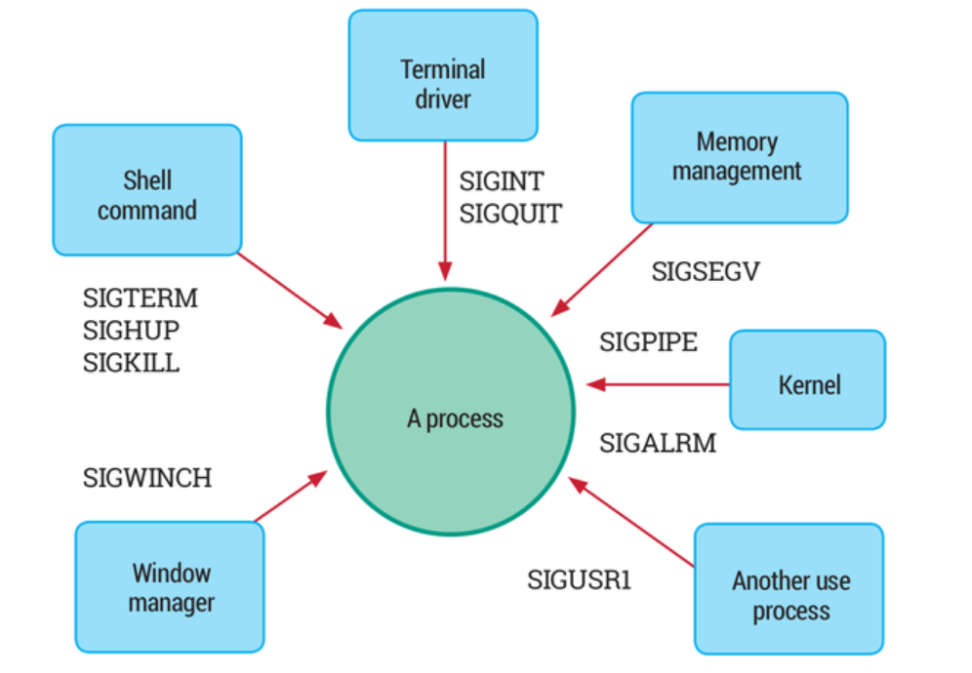
Linux Signals
www.lpu.in Lovely Professional University
‹#›

Slide 28
Activity
Pausing and resuming process from a Linux terminal,
www.lpu.in Lovely Professional University
‹#›

Slide 29
Kill command
The killall is a Linux only command. It kills processes by names.
Examples:
killall {Process-Name-Here}
killall -9 {Process-Name-Here}
killall -15 {Process-Name-Here}
kill the process using a PID (Process ID)
# kill 3486
PID can be searched using pgrep command
www.lpu.in Lovely Professional University
‹#›

Slide 30
Path Variable
It displays or set a search path for executable files at the command line.
Syntax PATH pathname [;pathname] [;pathname] [;pathname]... PATH PATH ; Key pathname : drive letter and/or folder ; : the command 'PATH ;' will clear the path PATH without parameters will display the current path.
The %PATH% environment variable contains a list of folders.
The PATH variable is an environment variable containing an ordered list of paths that Linux will search for executables when running a command.
For example, if we want to print Hello, world! in Bash, the command echo can be used rather than /bin/echo, so long as /bin is in PATH:
www.lpu.in Lovely Professional University
‹#›

Slide 31
Adding/Deleting a Path
Using the export command, new path can be added.
www.lpu.in Lovely Professional University
‹#›

Slide 32
Activity
Add to the path in Windows
www.lpu.in Lovely Professional University
‹#›

Slide 33
Other Shell Commands:
ls
cat
man
cd
touch
cp
mv
rmdir
mkdir
rm
chmod
pwd
ps
kill
www.lpu.in Lovely Professional University
‹#›

Slide 34
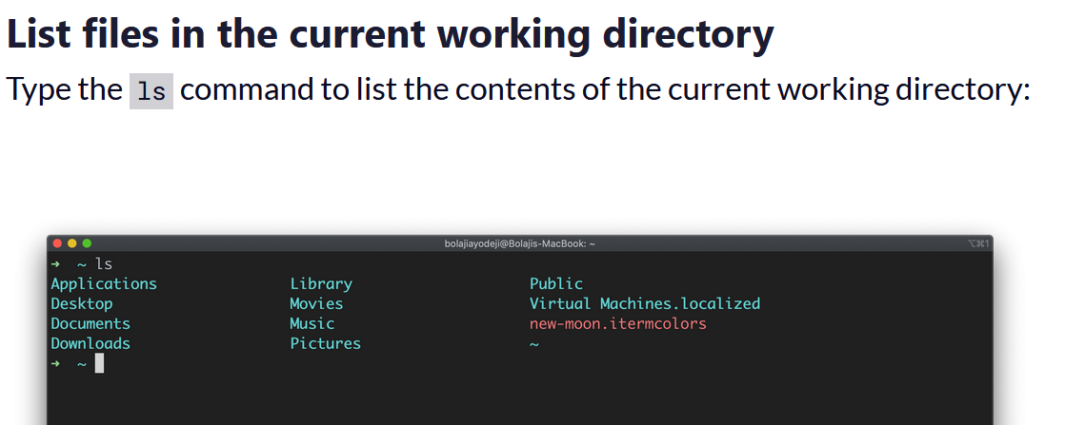
ls command
The ls command is used to list files or directories in Linux and other Unix-based operating systems.
Use of ls command as below:
www.lpu.in Lovely Professional University
‹#›

Slide 35
cat command
Outputs the contents of a text file.
You can use it to read brief files or to concatenate files together.
To append file1 onto the end of file2, enter:
cat file1 >> file2
To view the contents of a file named myfile, enter:
cat myfile
www.lpu.in Lovely Professional University
‹#›

Slide 36
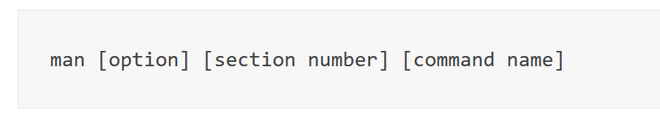
man command
The man command is a built-in manual for using Linux commands.
Displays the user manual of any command that we can run on the terminal. It provides a detailed view of the command which includes NAME, SYNOPSIS, DESCRIPTION, OPTIONS, EXIT STATUS, RETURN VALUES, ERRORS, FILES, VERSIONS, EXAMPLES, AUTHORS.
Basic Symbol
option – the search result output.
section number – the section in which to look for the man page.
command name – the name of the command which man page you want to see.
www.lpu.in Lovely Professional University
‹#›

Slide 37
cd command
It changes your current directory location.
By default, your Unix login session begins in your home directory.
To switch to a subdirectory (of the current directory) named myfiles, enter:
cd myfiles
To switch to a directory named /home/dvader/empire_docs, enter:
cd /home/dvader/empire_docs
www.lpu.in Lovely Professional University
‹#›

Slide 38
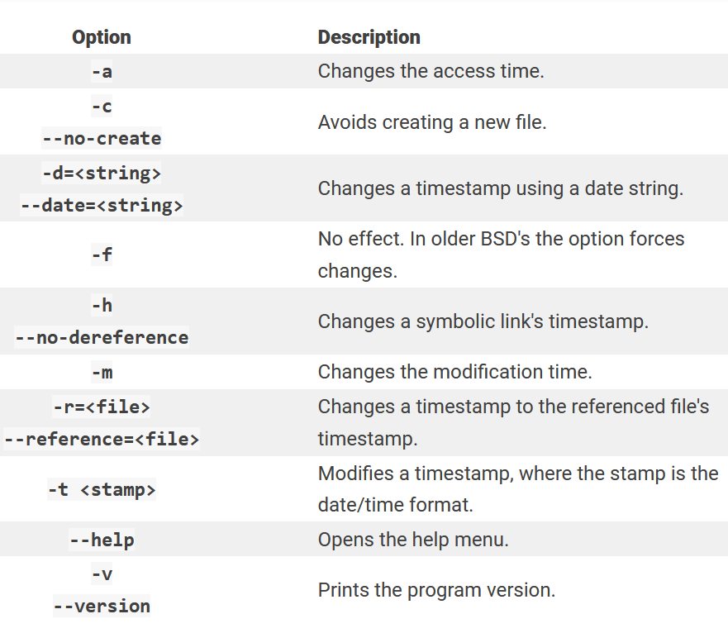
Touch
The touch command's primary function is to modify a timestamp.
www.lpu.in Lovely Professional University
‹#›

Slide 39
cp
This command copies a file, preserving the original and creating an identical copy.
cp -i oldfile newfile
mv
mv stands for move.
mv is used to move one or more files or directories from one place to another in a file system like UNIX.
Use it as:
mv [Option] source destination
chmod
This command changes the permission information associated with a file.
www.lpu.in Lovely Professional University
‹#›

Slide 40
Mkdir
The mkdir command is used to create (or make) a directory.
Example:
# mkdir LPUCSE
rmdir
The rmdir directory is used to remove directories, but only those that are empty (i.e., contain no files or subdirectories). In order to delete a directory with actual contents, you must use the rm -R command.
Example
To remove an empty directory:
# rmdir /mike
www.lpu.in Lovely Professional University
‹#›

Slide 41
Rm
Use the rm command to remove files you no longer need.
Example
Removing one file at a time
$ rm CSEA.txt
Pwd
Simply type pwd into your terminal, and the command will output the absolute path of your print working directory.
The pwd command writes to standard output the full path name of your current directory (from the root directory). All directories are separated by a / (slash). The root directory is represented by the first /, and the last directory named is your current directory.
The ps command, short for Process Status, is a command line utility that is used to display or view information related to the processes running in a Linux system.
www.lpu.in Lovely Professional University
‹#›

Slide 42
ps
The ps command, short for Process Status, is a command line utility that is used to display or view information related to the processes running in a Linux system.
kill
kill command in Linux (located in /bin/kill), is a built-in command which is used to terminate processes manually.
www.lpu.in Lovely Professional University
‹#›

Slide 43
Activity
Execute various commands on Linux Operating System
www.lpu.in Lovely Professional University
‹#›

Slide 44
Kernel and types of kernels
A Kernel is an intermediary between applications and hardware.
Functions of a Kernel
A Kernel in an operating system performs the following functions:
Device Management: Processes require various peripheral devices such as a mouse and keyboard connected to the computer to perform various tasks. The Kernel manages the allocation of the peripheral devices.
Resource Management: Kernel shares the resources between different processes while ensuring that every process has uniform access to the resources.
Memory Management: Every process requires some memory to execute. The Kernel allows the processes to access the memory safely.
Access Computer Resource: A kernel can access different computer resources such as RAM, CPU, I/O devices, and other resources. The Kernel decides which memory each process will use, and the action is taken if memory is unavailable.
www.lpu.in Lovely Professional University
‹#›

Slide 45
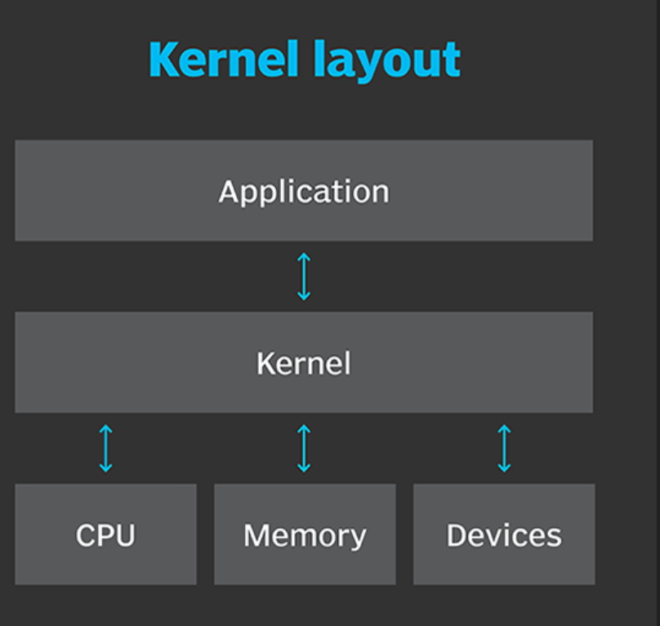
More about Linux Kernel
www.lpu.in Lovely Professional University
‹#›

Slide 46
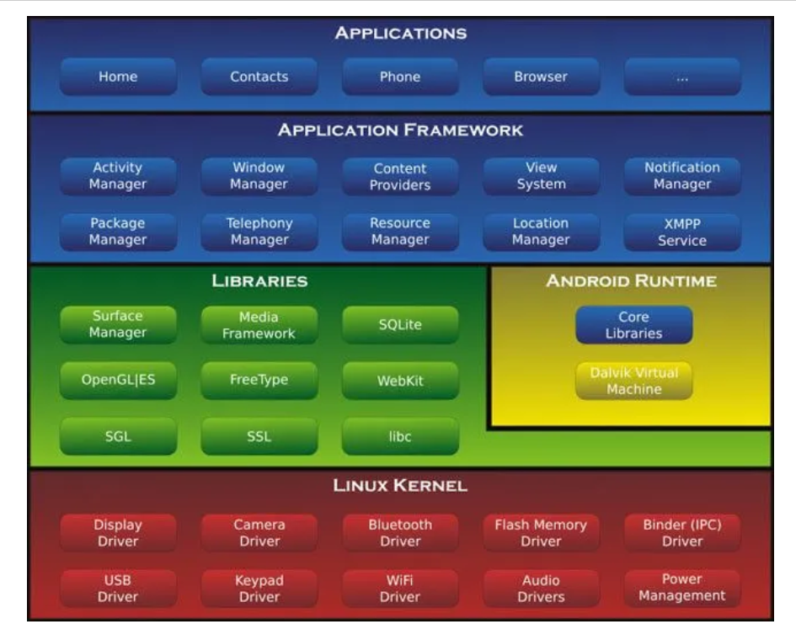
More about Linux Kernel
www.lpu.in Lovely Professional University
‹#›

Slide 47
Basic types of kernels
3 basic types of kernels as below:
Monolithic
Microkernel
Hybrid
A monolithic kernel is a type of kernel in which the complete OS runs in the kernel space.
A microkernel is a kernel type that implements an operating system by providing methods, including low-level address space management, IPC, and thread management.
A hybrid kernel is an operating system kernel architecture that attempts to combine aspects and benefits of microkernel and monolithic kernel architectures used in computer operating systems.
www.lpu.in Lovely Professional University
‹#›

Slide 48
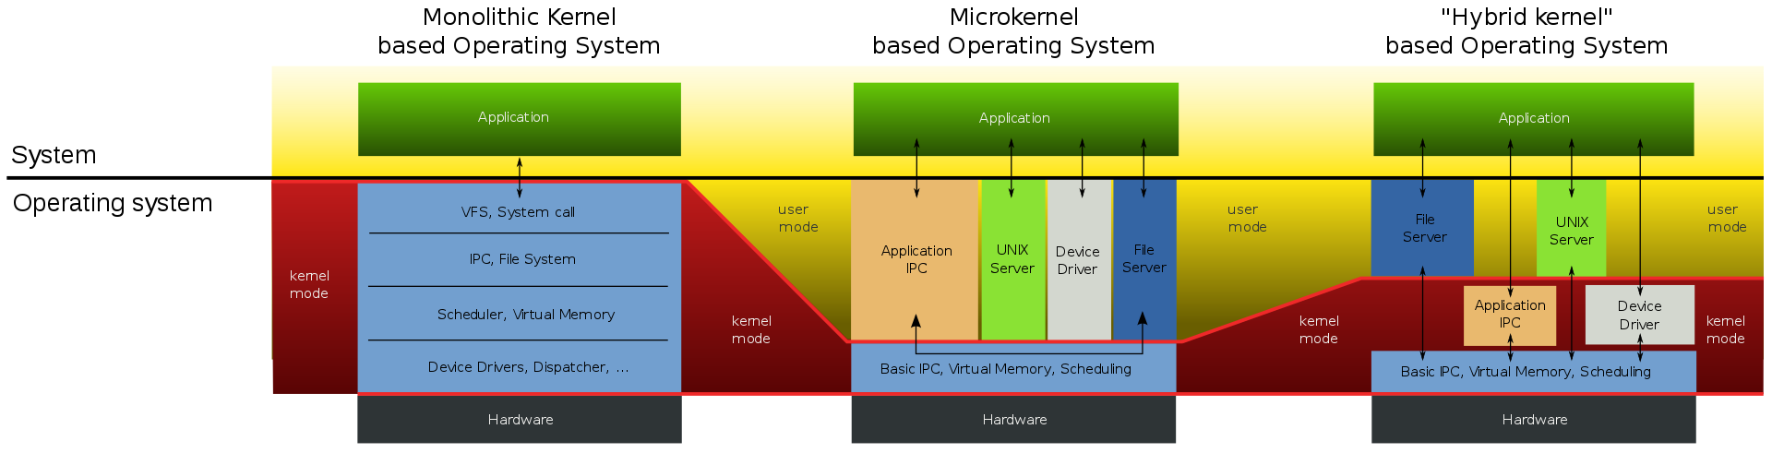
Basic types of kernels
www.lpu.in Lovely Professional University
‹#›
Notes:
https://en.wikipedia.org/wiki/Monolithic_kernel#/media/File:OS-structure2.svg
‹#›

